Slide 1

Quick Reference Parts Guide
Introduction
Main Menu
This Quick Reference Parts Guide is an easy way to locate part numbers to common replacement parts. It does not include items such as wire or their cord grips, terminal blocks, or mounting brackets. It also does not include standard hardware like nuts and bolts. To locate parts that are not covered here, refer to the drawing set in your equipment manual, part number 001094.
Navigating the
CD
Exit
www.mii.com
mitekparts@mii.com

Slide 2
Navigating the
Quick Reference Parts Guide
Main Menu
The next screen is the Main Menu, which has buttons to reach each category that this parts guide uses.
Each category may be further divided into different sections, each with their own button on the category’s main screen.
From each screen, you can:
  Return to the Main Menu
  Return to the category’s main page
  Go forward or backward one screen at a time within the category
  Click a link to order the part on-line or via e-mail
In addition to using the buttons provided, you can manually scroll through the screens by clicking your left mouse button.
Exit
How to get
To the
eStore
To access a different program or file while leaving the Quick Reference Parts Guide open, hold the Alt button while pressing the Tab button on your keyboard.
www.mii.com
mitekparts@mii.com

Slide 3
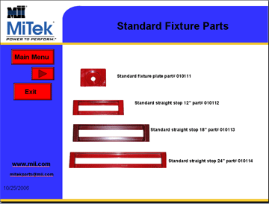

How to get to the eSTORE
Example
Once you find the part number you need, click on the web site link
www.mii.com
mitekparts@mii.com

Slide 4
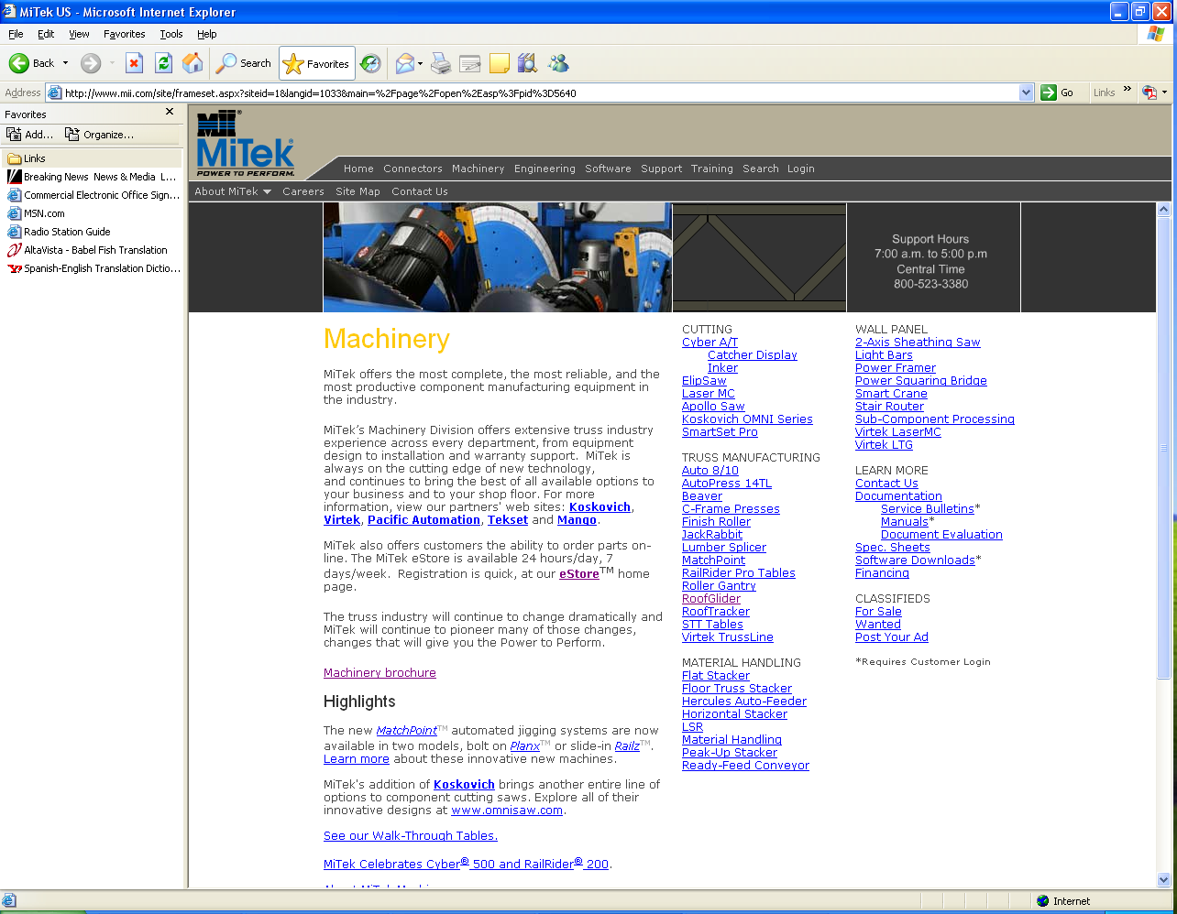
How to get to the eSTORE
www.mii.com
This is the web site, click on the machinery tab
mitekparts@mii.com

Slide 5
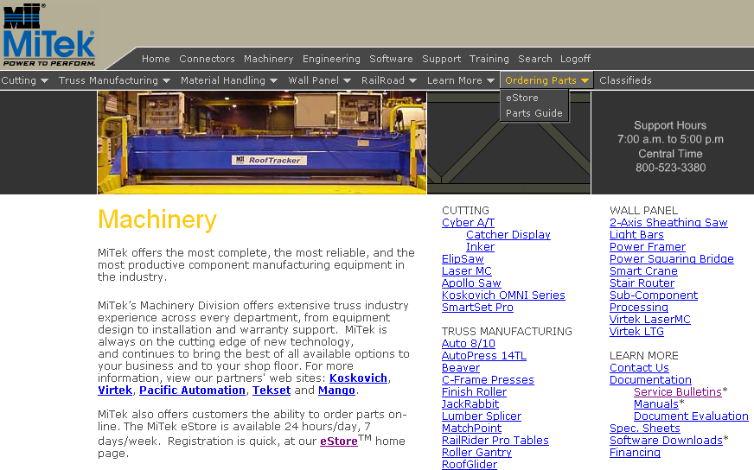
How to Get to the eStore
www.mii.com
mitekparts@mii.com
Click the Ordering Parts menu, then, click eStore.

Slide 6
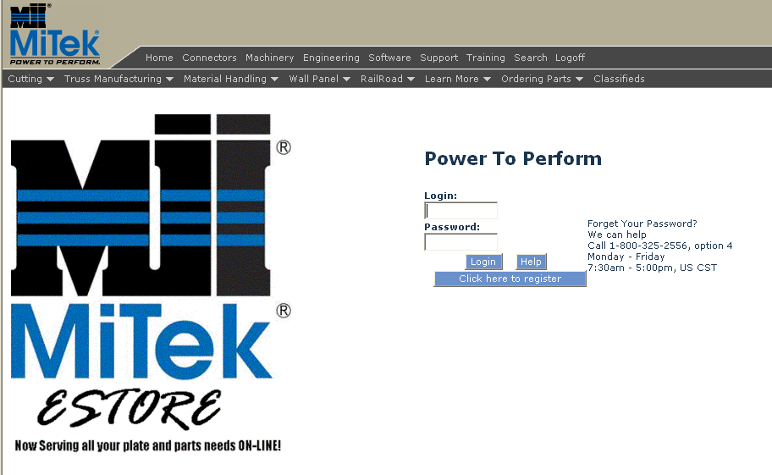
How to Get to the eStore
Main Menu
Exit
www.mii.com
Enter your eStore login and password and click Login.
If you need to register, click the Click here to register button.
mitekparts@mii.com

Slide 7
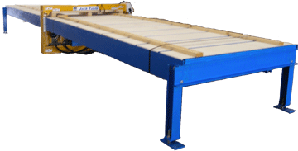
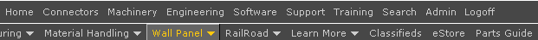
Jack Table
Main Menu
Navigating the
CD
Electrical Starter Panel
Electrical PB Panel
Exit
Motor and Limit Switch
Mechanical Parts
1
2
Hydraulic Parts
Click on the one of the links to the right to order your parts from our on-line eStore or via e-mail.
Table Top
Safety Labels
http://www.mii.com/machinery
www.mii.com
mitekparts@mii.com
mitekparts@mii.com

Slide 8
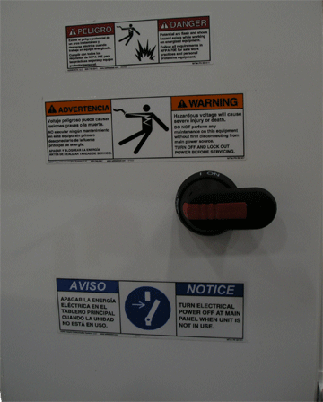
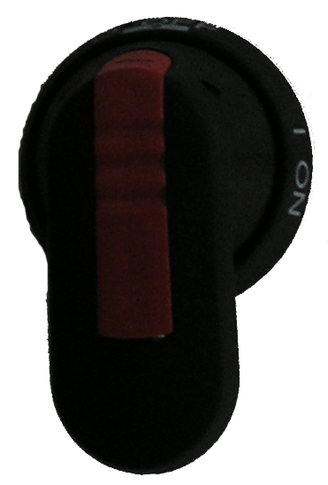
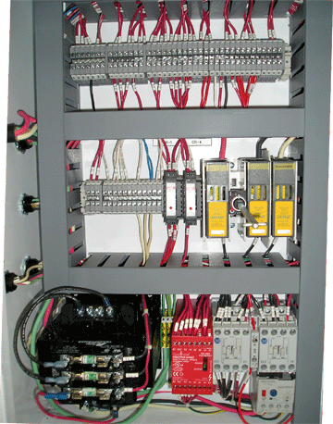
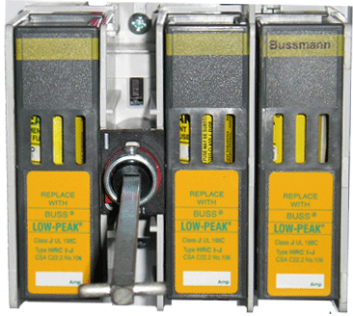
Electrical Starter Panel
Main Menu
All parts marked obsolete need to be replaced
(Disc handle part# 509423 OBSOLETE)
Exit
Incoming voltage to machine
Fuse for 208V/230V part# 516490
Fuse for 380V part# 516548
Fuse for 415V/460V part# 516488
Fuse for 575V part# 516487
(Disc fused switch part# 509422 OBSOLETE)
(Disc shaft part# 509430 OBSOLETE)
www.mii.com
New part numbers below
mitekparts@mii.com
Handel part# 509511
Shaft part# 509495
Disconnect part# 509455

Slide 9
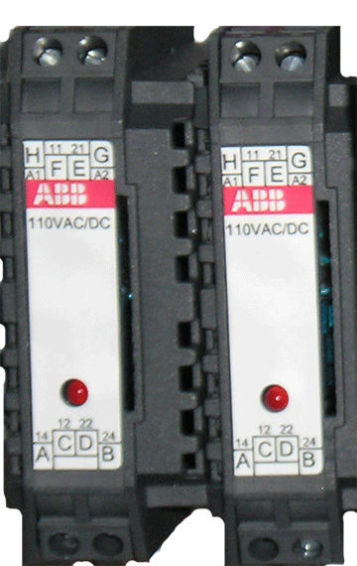
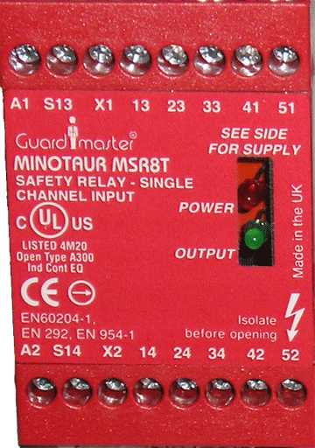
Electrical Starter Panel
Main Menu
Relay part# 514186
Exit
Safety relay part# 504603
www.mii.com
mitekparts@mii.com

Slide 10
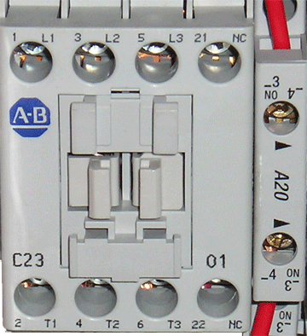
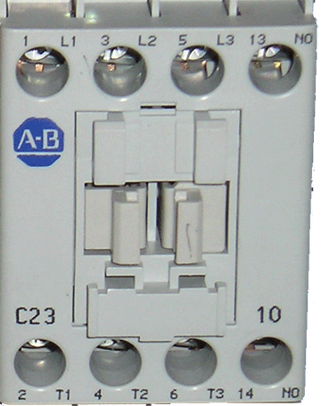
Electrical Starter Panel
Main Menu
Contactor part# 512023
Exit
www.mii.com
Contactor part# 512972
mitekparts@mii.com

Slide 11
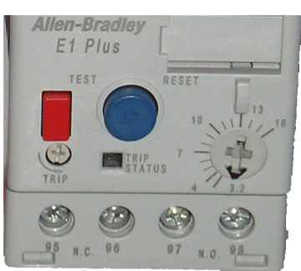
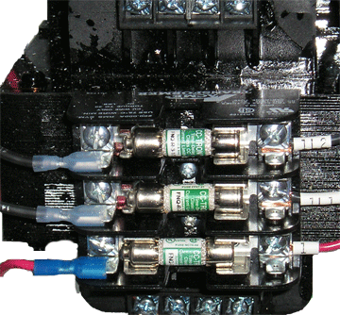
Electrical Starter Panel
Main Menu
Exit
Incoming voltage to machine
Overload for 208V part# 513011
Overload for 230V/380V/415V/460V/575V part# 512944
Transformer part# 509156
www.mii.com
mitekparts@mii.com

Slide 12
Electrical Starter Panel
Main Menu
Incoming voltage to machine
Fuses for 208V Qty 3 part# 516389
Exit
Fuses for 230V Qty 1 part# 516389
Qty 2 part# 516394
Fuses for 380V Qty 3 part# 516389
Fuses for 415V/460V Qty 1 part# 516389
Qty 2 part# 516394
Fuses for 575V Qty 1 part# 516389
Qty 2 part# 516388
www.mii.com
mitekparts@mii.com

Slide 13
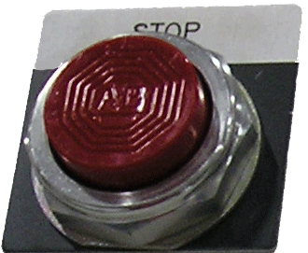
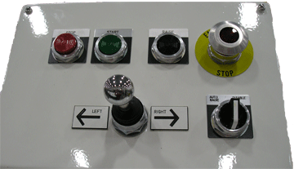
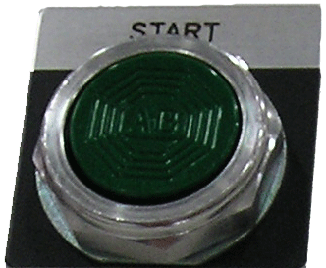
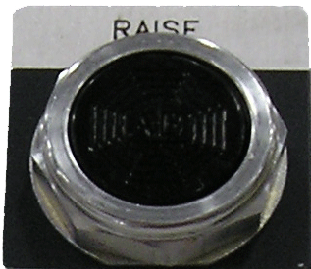
Electrical PB Panel
Main Menu
Operator part# 513638
Name plate part# 513152
Exit
Operator part# 513630
Name plate part# 513153
Operator part# 477021
www.mii.com
Name plate part# 477019
mitekparts@mii.com

Slide 14
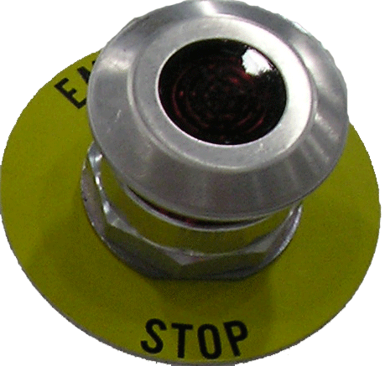
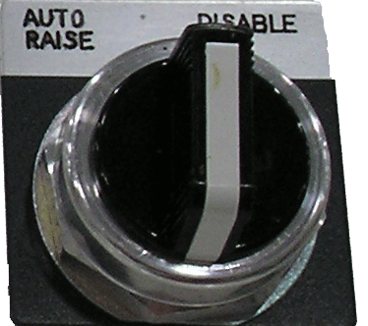
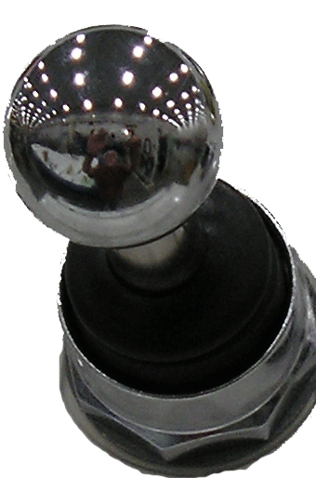
Electrical PB Panel
Main Menu
Exit
Operator part# 513516
Name plate part# 513191
Contact block part# 513181
Operator part# 513111
Name plate part# 513967
www.mii.com
mitekparts@mii.com
Operator part# 513966
Contact block Qty 2 part# 513182

Slide 15
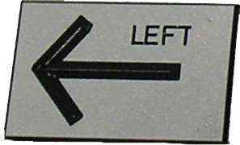
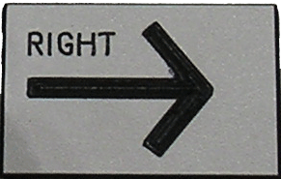
Electrical PB Panel
Main Menu
Exit
Name plate comes together right and left part# 513605
www.mii.com
mitekparts@mii.com

Slide 16

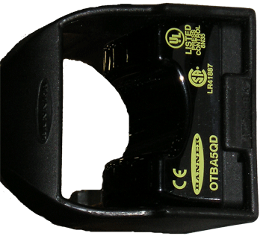
Electrical PB Panel
Main Menu
Pilot light part# 513597
Name plate auto rise enabled part# 513970
Exit
Name plate replace filter part# 513969
Switch opto touch part# 528109
Cable part# 528110
www.mii.com
mitekparts@mii.com

Slide 17
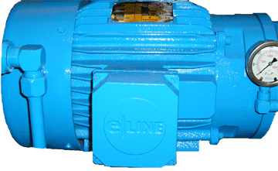
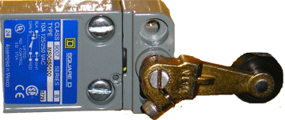
Motor and Limit Switch
Main Menu
Motor part# 471004
Does not come with gauge or tube and fitting
Exit
Limit switch part# 515043
www.mii.com
mitekparts@mii.com

Slide 18
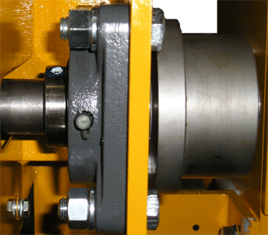
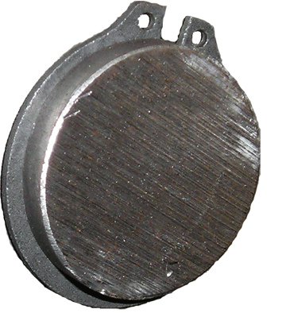
Mechanical Parts
Main Menu
Trolley wheel Qty 4 per machine part# 30035
Exit
Trolley motoring axle Qty per machine 2 part# 30034
Bearing Qty 5 per machine part# 419112
www.mii.com
mitekparts@mii.com
Snap ring Qty 8 per machine part# 379011

Slide 19
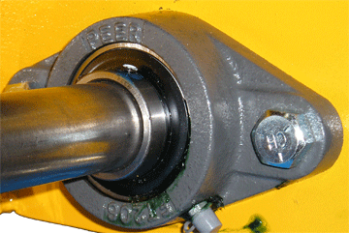
Mechanical Parts
Main Menu
Bearing Qty 2 per machine part# 419134
Exit
www.mii.com
mitekparts@mii.com

Slide 20
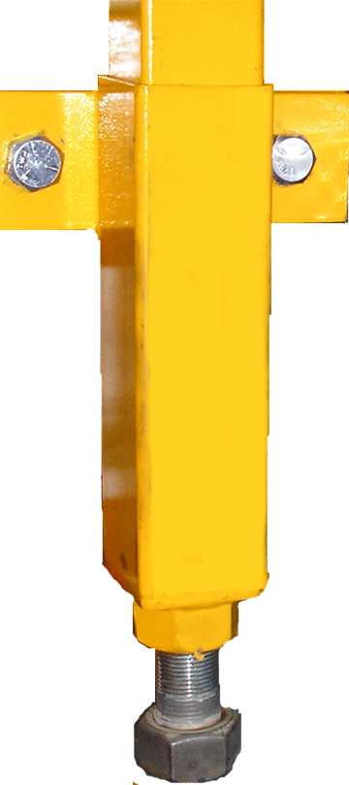
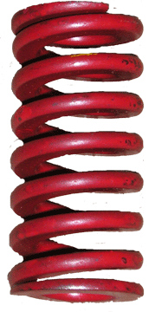
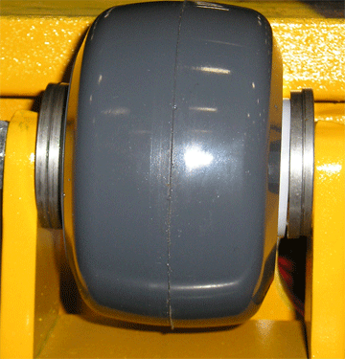
Mechanical Parts
Main Menu
Support wheel weldment part# 30012-501
Die spring part# 370002
Lower support weldment part# 30011-501
Exit
Support wheel tensioner part# 30013-501
Wheel Qty 1 per assembly part# 580006
www.mii.com
Thrust washer Qty 4 per assembly part# 404001
mitekparts@mii.com

Slide 21
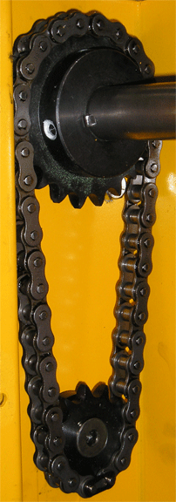
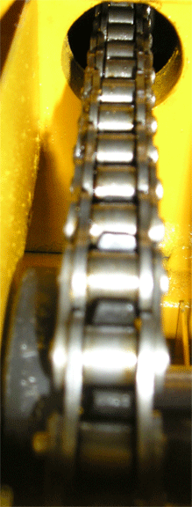
Mechanical Parts
Main Menu
Sprocket Qty 3 per machine part# 551001
Chain sold by the foot
Exit
Chain #50- 27 ½” part# 554006 need to order 3ft.
Sprocket part# 551002
Chain sold by the foot
www.mii.com
Chain #50- 16 3/8” part# 554006 need to order 2ft.
mitekparts@mii.com

Slide 22
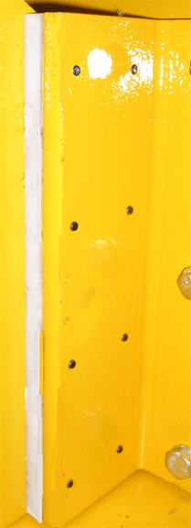
Mechanical Parts
Main Menu
Socket head cap screw Qty 38 per machine part# 325161
Exit
Guide bar Qty 4 per machine part# 30045
www.mii.com
mitekparts@mii.com

Slide 23
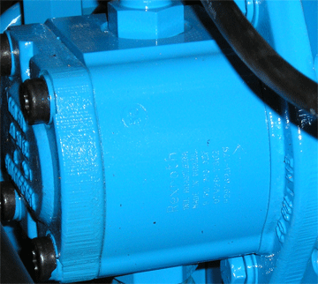
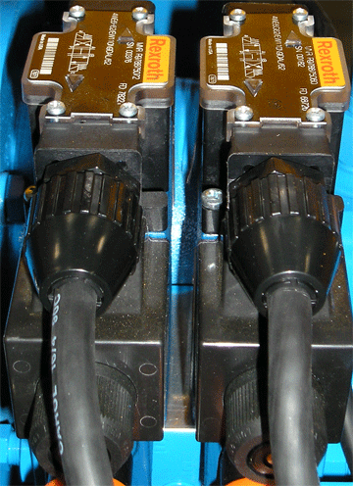
Hydraulic Parts
Main Menu
Pump part# 800007
Exit
Valve part# 802007
www.mii.com
mitekparts@mii.com
Valve part# 802006

Slide 24
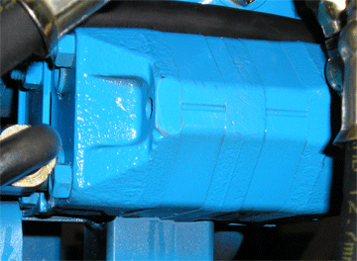
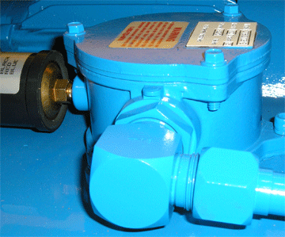
Hydraulic Parts
Main Menu
Flow divider part# 802006
Exit
Filter part# 438021
Filter element part# 438022
Filter alarm switch part# 805248
www.mii.com
mitekparts@mii.com

Slide 25
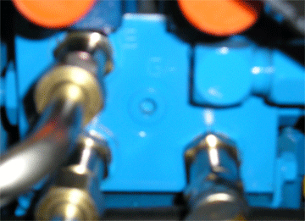
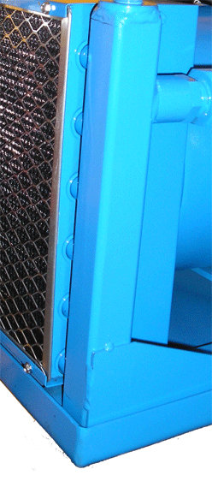
Hydraulic Parts
Main Menu
Manifold part# 804005
Exit
Heat exchanger part# 809001
www.mii.com
mitekparts@mii.com

Slide 26
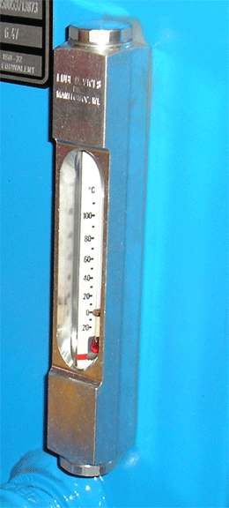
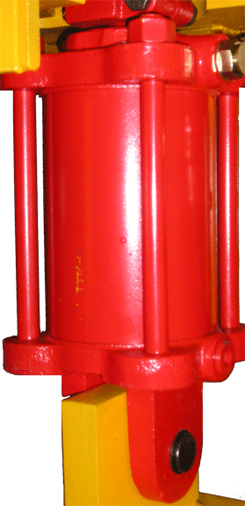
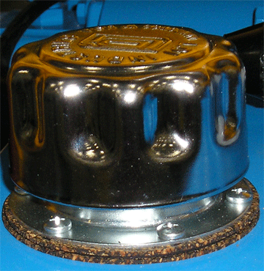
Hydraulic Parts
Main Menu
Sight gauge part# 806305
Exit
Hydraulic cylinder part# 798002
Filler vent cap part# 806293
Clevis pin part# 400005
www.mii.com
mitekparts@mii.com

Slide 27
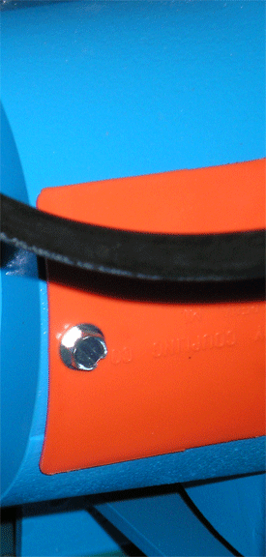
Hydraulic Parts
Main Menu
Pump/motor adapter part# 806003
Exit
Inside pump/motor adapter
Coupling motor side part# 557005
Coupling pump side part# 557004
www.mii.com
mitekparts@mii.com

Slide 28
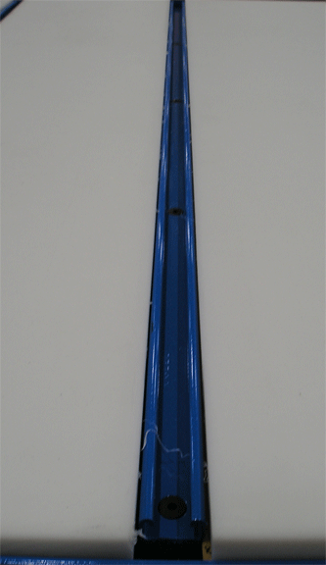
Table Top
Main Menu
End piece top part# 83500643072-002
Exit
All middle pieces part# 83500643072-001
Unistrut part# 30066
www.mii.com
mitekparts@mii.com

Slide 29

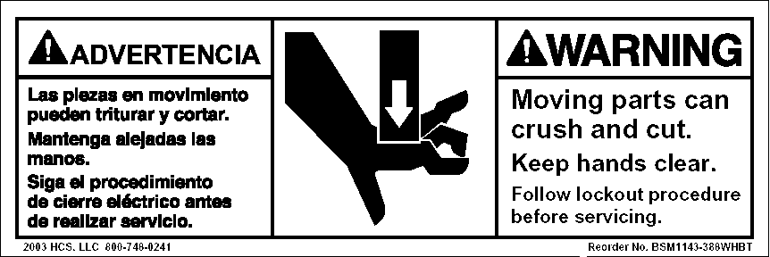
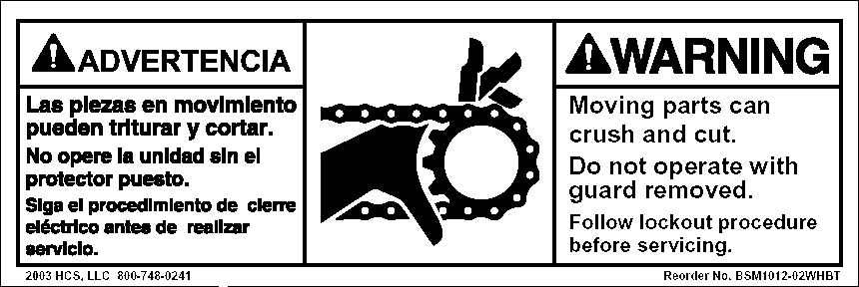


Safety Labels
Main Menu
Part# 691528
Exit
Part# 691501
Part# 691500
Part# 691507
www.mii.com
mitekparts@mii.com
Part# 691701

